Slide 1

Feb 2025
VART
LAUNCH
Kickstart Your Journey.

Slide 2
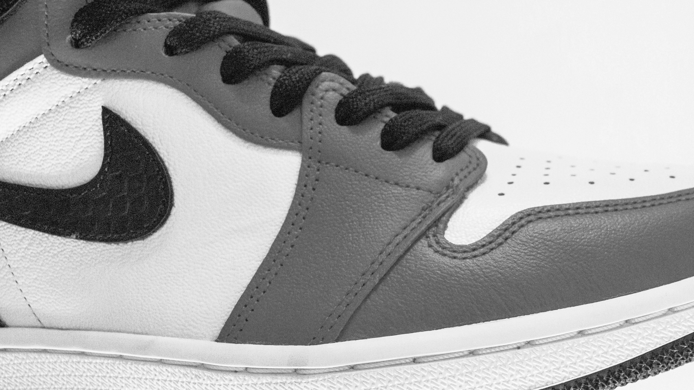
This is our plan
Feb 2025
Things good programs don’t do!
DIDACTIC
HYBRID
SOLUTION
CAAHEP STANDARD III. C
APPENDAGE A
CURRICULUM
DISTANCE LEARNING
CAAHEP STANDARD IV. B
APPENDAGE B
OUTCOME ASSESSMENT
THE FOUR (4)
“VART CONCEPT”
EVERYTHING
🔑“CREATE VALUE”🔑
SUCCESS
Notes:
OFFER
Self-driven study..
Student voices panel..
CAN YOU HELP ME?

Slide 3

VART
Feb 2025
WHAT IS VART?📚
Getting students to respond to the information we have!
VIDEO – CPU / Laptop / iPad
AUDIENCE – Android/ iPhone
RESPONSE – Better / Bitter
TECHNOLOGY – the LMS’s
DON’T LET OUR DIFFERENCES PULL US APART! “RELATIONSHIPS”🔦
Notes:
Focus on the Benefit!
Quality has to go in before the name tag goes on!
Find the right strategy!

Slide 4

THE V - VIDEO
Feb 2025
RELATIONSHIPS?
INTERACTIVE LESSONS – use videos to explain complex topics visually.
VIRTUAL FIELD TRIPS – videos can take students to places they can’t physically visit.
STUDENT CREATED CONTENT – Students create their own videos to demonstrate understanding of a topic improving both creativity and comprehension.
LIVE STREAMING AND WEBNAIRS
FLIPPED CLASSROOM MODEL – pre-recorded lectures as homework allowing classroom time for discussions and hands-on activities.
Notes:
BENEFITS..❤️
Retention NP.
Outcomes thru roof..
Unforgettable experience(s)..
Sebastian..

Slide 5
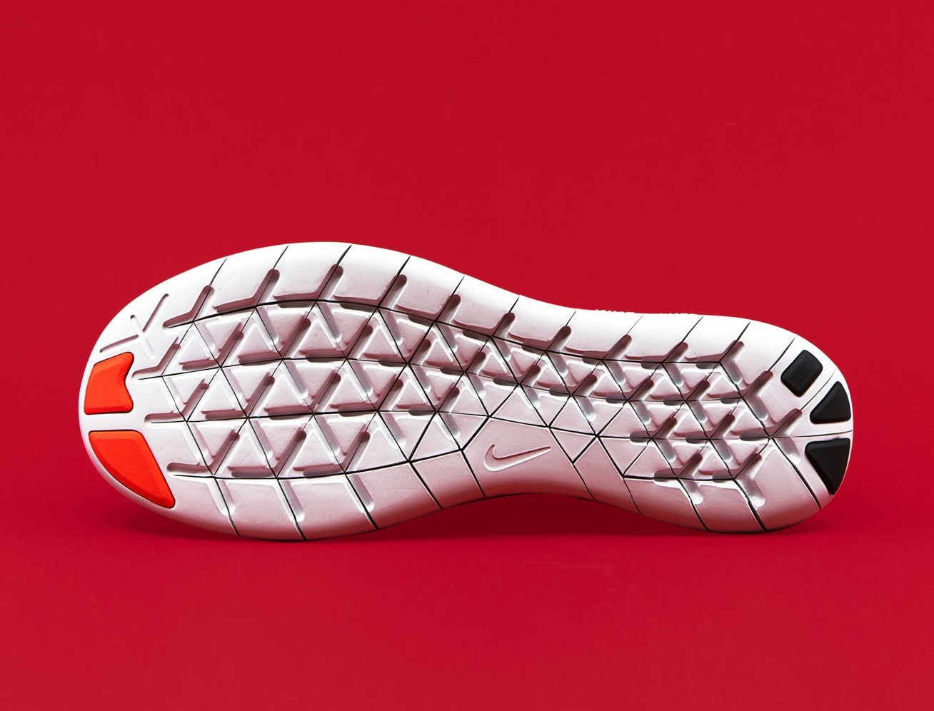
THE A - AUDIENCE
Feb 2025
WHATS IN YOUR WALLET?
TOOLBOX?🧰
GRAB / HOLD / EXCHANGE (RELATIONSHIP)*
PODCAST AND AUDIO BOOKS – Preference or visual impairments
VOICE RECORDERS – Document student reflections
SOUND EFFECTS AND MUSIC – Enhance storytelling or drama lessons with relevant audio elements
ASSISTIVE TECHNOLOGY – Students with hearing or visual challenges
Notes:
One thing at a time before moving on!🏃🏽‍♂️
EXPOSURE..
What if you surrounded yourself with problem solvers?
Application 🔥

Slide 6
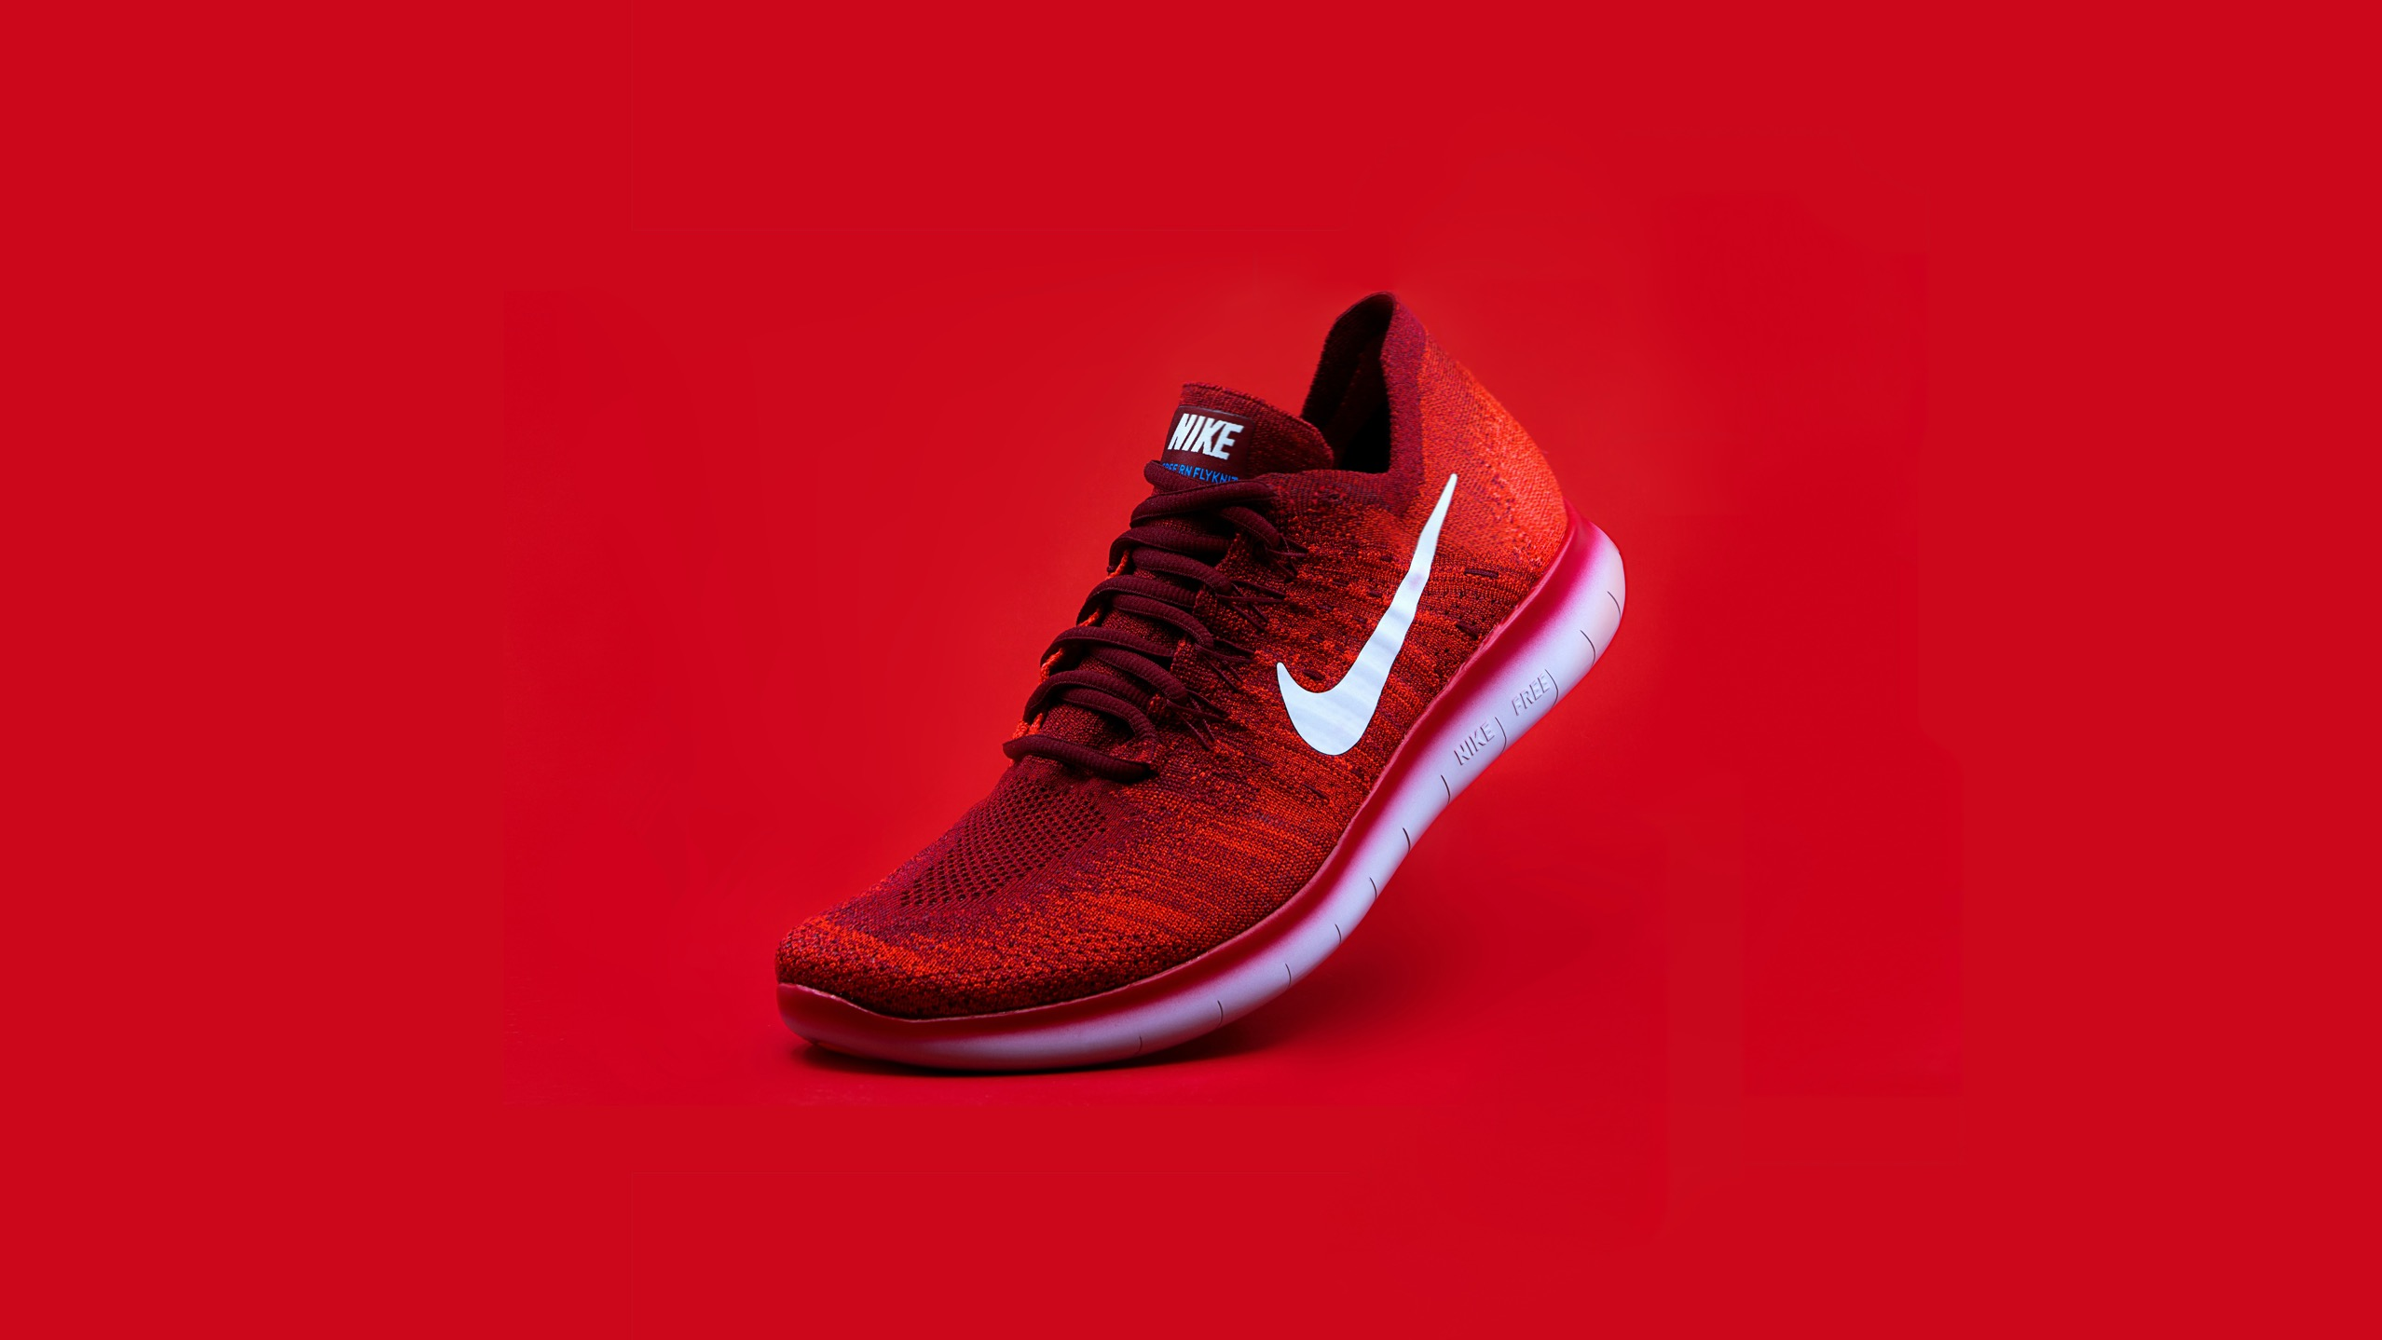
THE R – RESPONSE/benefits
Feb 2025
SHOCK ABSORPTION:
MODERN DESIGN:
ENGAGEMENT
Multimedia content, captures attention, more effectively than traditional lectures..
FLEXIBILITY
Content can be assessed anytime, anywhere, allowing for self-paced learning.
BREATHEABLE UPPER:
RUBBER OUTSOLE:
ACCESSIBILITY
Video and audio tools, support, inclusive, education, helping students with disabilities or language barriers..
COLLABORATION
Tools that encourage group work, discussions, and peer reviews.
Notes:
Get people to know, like, and trust you.
That’s VALUE..💍
“Organic focus” 4
PLACEMENT
RETENTION
STUDENT SATISFACTION, EMPLOYER, SATISFACTION

Slide 7
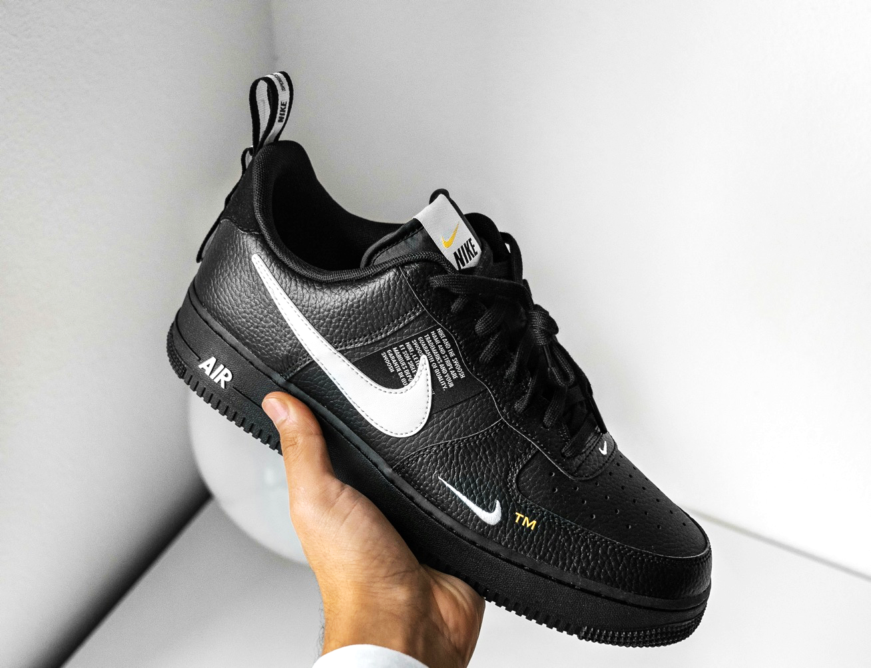
THE T – TECHNOLOGY
Feb 2025
What makes
“u” special?🧩
PLAN AHEAD – integrate videos or audio resources that align with curriculum goals.
TEST EQUIPMENT – ensure all technology works seamlessly before the lesson begins.
ENCOURAGE INTERACTION – ask questions or assigned task related to the content to keep students engaged.
EVALUATE EFFECTIVENESS – gather feedback to understand how well the technology supports learning objectives.

Slide 8

Our inspiration
Feb 2025
Our Target🎯
Incorporating DIVERSITY, EQUITY, AND INCLUSION in the classroom/clinical is essential for creating non-discriminatory, educational environments.
Statistics demonstrate how DEI practices impact student engagement, achievement, and overall educational equity.
Here are some key data points and insights related to DEI in education.
Notes:
THE VALUE …🔎
Teach what made you think?
Customer Survey..
Use Ai tools to create content

Slide 9

Our costumer’s need
Costumer
Pain Points⛽️
DIVERSITY STATISTICS..
Enrollment Pain
Achievement Pain
Outcome Pain
Strategic Pain
In the US, over 50% of public school students identify as part of the racial or ethnic minority group (NCES, 2020).
By 2025, it is projected that students of color will make up the majority in US classrooms.
Approximately 10.4% of US students are English language learners, highlighting the need for culturally, responsive teaching (NCES, 2022).
72% of undergraduates received some type of federal student aid in 2019-2020 (NCES, fast facts 2023)

Slide 10

Our solution
POLLING
GAMIFICATION
Schools with majority, BLACK and HISPANIC students receive $23 billion less in funding annually compared to predominantly WHITE schools (EdBuild, 2020).
LOW INCOME students are 4.5 times more likely to attend schools with Fuel resources, affecting their access to advanced coursework and technology.
EXAM
BLACK STUDENTS are 3.8 times more likely to be suspended than their WHITE PEERS, contributing to the school to prison pipeline (U.S. Department of Education, 2021).
HOW VART HELPS SOLVE THE PROBLEM..
Notes:
BETTER / BITTER
Practice Thinking..
Start Thinking..
Testing What You Know..
Weekly Motivation..

Slide 11



Ways to Inclusion..
Feb 2025
WAYS TO USE V.A.R.T📕
Use 1
Use 2
Use 3
Culturally Responsive Teaching Impact!
LGBTQ+ Students!
Social-emotional skills like empathy and collaboration!
Notes:
KEEP MOVING..

Slide 12
REPRESENTATION IN MEDIA
Feb 2025
COMPETATIVE LANDSCAPE..
High
Your
Students
Incorporating diverse voices in video and audio content help students see themselves reflected in the curriculum.
86% of students report feeling more engaged when content reflects their culture and background (EdUtopia, 2021).
Competitor 1
Competitor 3
Functionality
Competitor 2
Low
Small
Class/Clinical
Size
Large
Notes:
Correlation
FUNCTIONALITY
High or Low
SIZE
Small or Large

Slide 13
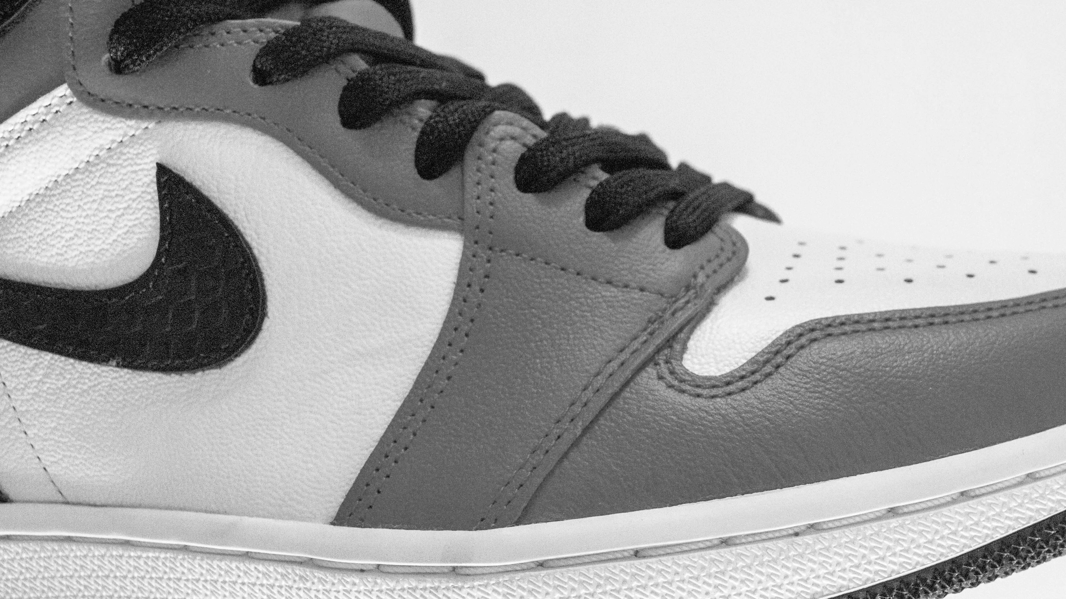
Our strategy
Feb 2025
TRAINING..CEUs
Strategy Gap
Strategy Gap
#
$
Only 40% of teachers report receiving training on culturally, responsive, teaching practices (Education Week, 2022).
Teachers who undergo DEI training are 35% more effective in engaging diverse classrooms and clinicals.
Notes:
Is it in the numbers?
Is it pay?
Always about PRODUCTION..

Slide 14
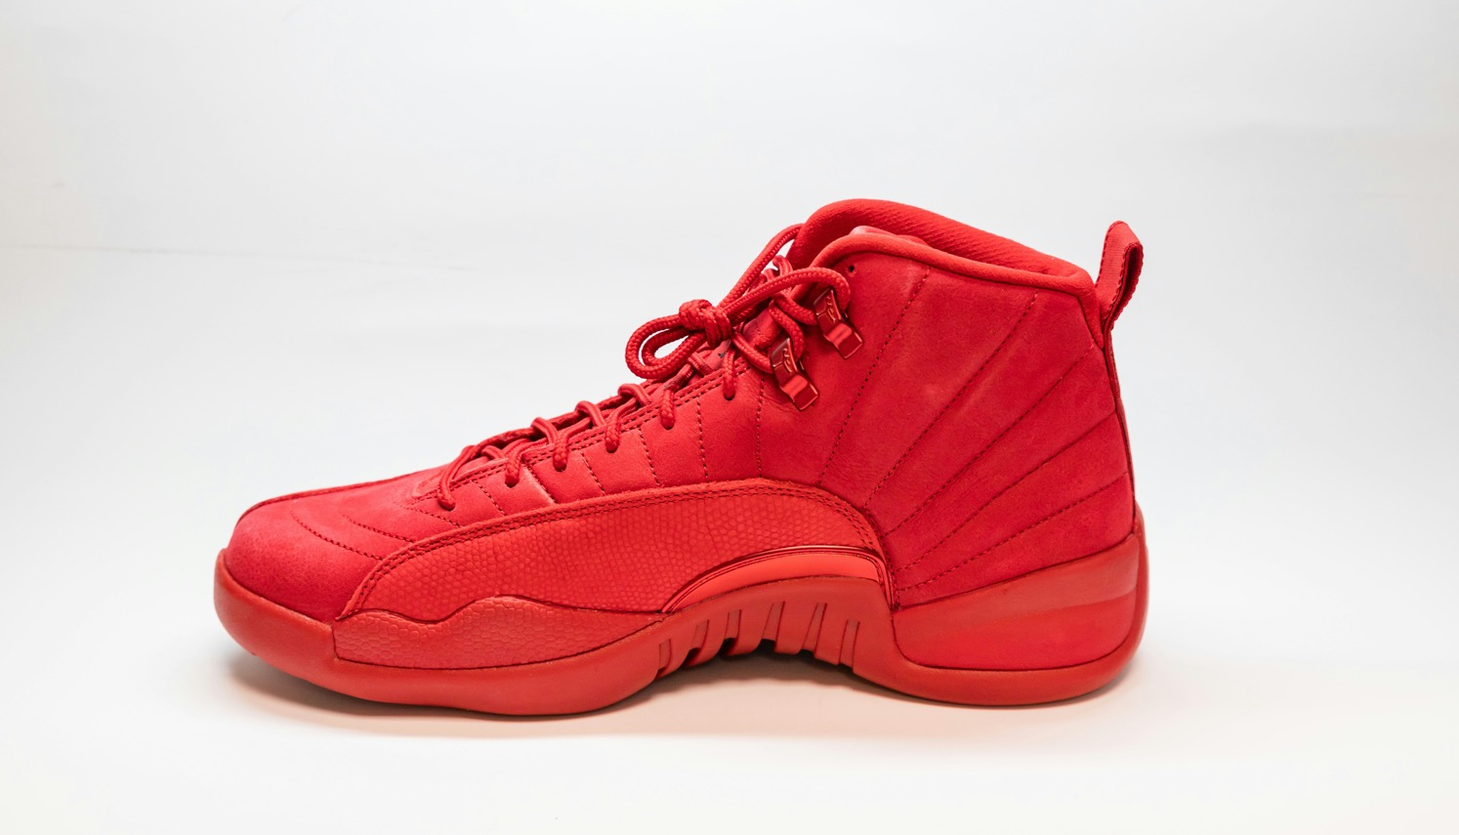
THE VIEW
Feb 2025
Accessing high-quality instruction from anywhere!📲
Material
Outcomes
Experiences
Constraints
Engagement
Retention
Notes:
NO RISKS WITH THESE..
NO REWARDS..

Slide 15
We care about you
QUALITY ASSURANCE:
This is what we are made of..
Our product shows..how we think and what we are made of.
Quality “MUST” go in before the name tag goes on.
Warranty
& Support
Information
SERVICE COMMITMENT:
Problem solver/solving problems?
We anticipate
We see the bigger picture
We handle one thing at a time before moving on.
Can you help me? We sure can.
Notes:
Money back guarantee?
30, 60, 90 days
6, 9, 1 year..
CONSISTENCY..
Not speed but accuracy!

Slide 16
VART
Feb 2025
KEY TAKEAWAYS!🔑
Channel Energies here..
DIVERSE AND INCLUSIVE CLASSROOMS / CLINICALS - promote engagement, stronger, academic outcomes, and improved emotional well-being for students from all backgrounds.
CONCLUSION:
INVEST IN VART CLASSROOMS/CLINICALS.
NOT JUST SPACES FOR LEARNING, BUT ENVIRONMENTS WHERE EVERY STUDENT FEELS VALUED, SUPPORTED, AND EQUIPPED FOR SUCCESS.*
YOU ARE THE PATIENT EXPERIENCE!
Everyone stand up please..
That’s just the way it is some things will never change.
Drop the Mic!
Channel Energies here..
EQUITY PRACTICES – address systemic disparities by providing resources and opportunities tailored to marginalized groups.
Channel Energies here..
TECHNOLOGY INTEGRATION – using inclusive video and audio materials, fosters a sense of belonging and encourages empathy amongst students.*
Notes:
Sebastian
Sebastian
Sebastian
Bruce Hornsby..

Slide 17
Credits
Mayer, R. E. (2021)
Multimedia Learning: Principles and Applications
• This book explores how multimedia tools, such as video and audio, can enhance learning by leveraging dual-channel processing (visual and auditory) in students.
Guo, P. J., Kim, J., & Rubin, R. (2014)
How Video Production Affects Student Engagement: An Empirical Study of MOOC Videos.
• This study found that shorter, well-designed videos increase student engagement in online and hybrid classrooms.
• Available at: https://www.edx.org
Kaltura (2022)
The State of Video in Education.
• Annual report discussing trends and benefits of video integration in education, such as increased engagement and knowledge retention.
• Available at: https://corp.kaltura.com
Mitra, B., Lewin-Jones, J., Barrett, H., & Williamson, S. (2010)
The Use of Video to Enable Deep Learning.
• This study highlights how video content supports critical thinking and deeper understanding in higher education contexts.
• DOI: 10.1016/j.compedu.2010.02.002
Hattie, J. (2009)
Visible Learning: A Synthesis of Over 800 Meta-Analyses Relating to Achievement.
• Hattie emphasizes that visual and auditory tools significantly improve understanding when combined with effective pedagogy.
Edutopia (2020)
How Multimedia Enhances Learning in the Classroom.
• Explores practical ways to incorporate video and audio tools to accommodate different learning styles and increase accessibility.
• Available at: https://www.edutopia.org
National Center for Education Statistics (NCES, 2022)
Digital Learning Trends in K-12 Education.
• Discusses the role of audio and video technology in bridging educational gaps and providing diverse content for learners.
• Available at: https://nces.ed.gov
Fadel, C., & Lemke, C. (2008)
Multimedia and Learning: The Role of Media in the Classroom.

Slide 18

Join us today!
Feb 2025
Let’s Work Together!
Contact e-mail
Contact e-mail
Website
Phone
dailatem@gmail.com
jrnewkirk@gmail.com
TBA
(123) 456-7890

Slide 19

We hope you liked it!
Feb 2025
THANK YOU
For Kickstarting
Your Journey with us.

Slide 20

Answering your questions
Feb 2025
Q&A
session
Let’s answer some questions

